Slide 1

Xecure Password Manager
Date: April 20, 2022
Student: Carlos R. Ocasio
Major: Cybersecurity
Course: CSCI 499 Senior Project Defense
Advisor: Prof. Henderson

Slide 2

Introduction
Management of passwords is one of the most important aspects of Cybersecurity.
Strong and unique passwords are vital for account security.
Most users have far too many online accounts to remember a unique password for each account.
The average user has over 90 different online accounts.
Notes:
The management of passwords is one of the most important aspects of Cybersecurity and it is imperative that users implement and practice safe password management practices.
The first step to implementing these safe practices should be to ensure that you are creating strong and unique passwords for every one of your online accounts.
Unfortunately, most users have far too many online accounts to remember a unique password for each account.
A 2020 survey indicates that the average user has over 90 different online accounts….. So imagine having to remember that many passwords.

Slide 3

Problem
A Google survey found that 52% of users reuse the same password for multiple accounts.
There is a limit to how many passwords a user can remember.
Reusing passwords:
Leaves users vulnerable to intrusion attacks.
Result in data loss, monetary loss and more.
IBM (2020) found that the average cost of a data breach is $3.68 million.
Notes:
A 2019 Google Online Security Survey found that 52 percent of users reuse the same password for multiple accounts.
We all know that there is a limit to how many passwords a user can remember.
The problem with this limit is that it can lead to users reusing the same passwords for multiple accounts (sometimes even all of the accounts)
The practice of reusing passwords leaves users vulnerable to intrusion attacks, which can result in data loss, monetary loss and more.
A report conducted by IBM (2020) found that the average cost of a data breach is $3.68 million, while a data breach in the healthcare industry is estimated to cost around $7.13million.

Slide 4
Solution
Password managers can easily eliminate all the difficulties that are associated with having unique and complex passwords.
Password managers store all the passwords in a secured vault that can be accessed with a “master” password.
No need to remember multiple passwords.
Greatly reduces the chances of having multiple accounts compromised.
Notes:
By using a password manager users can easily manage unique passwords for their accounts while eliminating all the difficulties that are associated with complex passwords.
With a password manager users can store all their passwords in a secured vault that can be accessed with a “master” password.
This eliminates the need to remember multiple passwords and greatly reduces the chances of having multiple accounts compromised.

Slide 5

Password Managers
Most Popular Password Managers:
KeePass
LastPass
1Password
Dashlane
NordPass
Industry Standards:
Password Encryption
Hashing used for authentication
Automatically copy password to clipboard
Sanitize clipboard
Generates strong passwords

Slide 6




Xecure Password Manager
Xecure is a password manager application for Windows computers.
Securely stores and manages log in information.
Uses MYSQL database to store user data.
Uses encryption and hashing to protect user data.
Notes:
That is why I created the Xecure application
Xecure is a password manager application for Windows computers.
It securely stores and manages log in information for registered users.
It uses a local MYSQL database to store all of the user data.
And it uses encryption and a hashing algorithm to protect all of this user data.

Slide 7
Implementation Languages & other requirements
System Requirements:
Windows 10 or Windows 11
Python 3.9.7
MySQL Server (8.0.26)
Libraries & Packages:
Hashlib
Cryptography
Msvcrt
Mysql.connector
Os
Getpass
Random
Smtplib
Socket
Time
Pyperclip
Threading
Software:
MySQL Workbench 8
More information and installation instruction on: https://github.com/Xcar17/Xecure-Password-Manager
Notes:
In ordered to run the program you need the following things:
Windows 10 or Windows 11 system
You need to have Python 3 and a MySQL Server installed
And you also need the version 8 of MySQL Workbench
These are all of the libraries and packages that are used by the program. If you would like more information on what these do and how to install the program, please visit the github repository

Slide 8
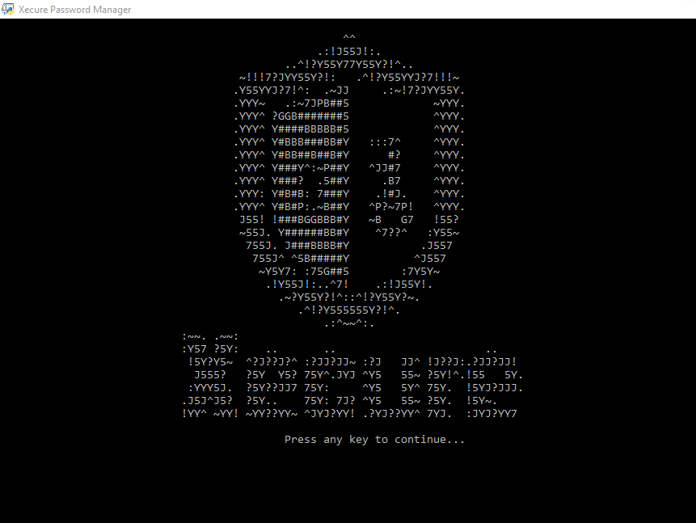
Major Features
Uses SHA-256 to authenticate users.
No need to store “master” password.
Uses AES-256 to encrypt data before sending it to the database.
Uses prepared statements to prevent SQL injections.
Notes:
The hashing algorithm it uses is SHA-256.
The way this is used within my application is that whenever a user registers, their username and password are combined into a single string. This string is then hashed and stored in the database. This hash can later be used to uniquely identify and authenticate every user, whenever they attempt to login.
Now, In order to secure all of the information stored within the database, the AES-256 standard is used to encrypt all of the data. Xecure’s encryption algorithm also contains a salt that prevents users from having the same ciphertext, and this is all done before sending the data to the database.
The current version of the database is stored locally, but it can be scaled up to an online database and this is why it was important for me to encrypt the data before sending it .
In either case, prepared statements were used with every single SQL query, and this was done in order to prevent SQL injections.

Slide 9

User Features
Users can create accounts.
Create and save records.
Generate strong password for records.
Retrieve records.
Automatically copy password to clipboard.
Update records.
Account recovery.
Live Demo…
Notes:
Here’s a rundown of all the major features that users can take advantage of…but instead of talking about them why don’t we do a live demonstration.

Slide 10

Test Plan
Create a document containing test cases.
Fix findings.
Create a usability test for volunteers.
Fix any new findings
Notes:
After I had a prototype for the application, I began the testing process. The first step of this process involved creating test cases for the application.
My goal with the test cases was to describe in detail the behavior of the application under every possible scenario.
Of course, this is impossible, but I wanted to use the time that I had to run it through this testing cycle that you see up here.
I spent so much time developing this application that it was very difficult for me to disconnect myself from it and see it from the perspective of others.
So, I wanted to get feedback from real users. This feedback would then be used to fix any findings and improve the application, and then the cycle would begin again.
I was able to run my application through this process a total of 3 times, and it gave me a pretty good idea on how to improve the application and what its major flaws were.

Slide 11

Usability Test Results
Users wanted a way to back out of menus.
Users did not want to remember a user ID.
Verification Codes were too complicated.
Email addresses were case sensitive.
Recovery emails needed more details.
Notes:
Users wanted a way to back out of menus. Having a user stuck in a loop is never a good idea, so a command to backout of every screen was implemented.
The initial prototype of the application, asked for user to remember a user ID. This was used to log in to the application along with the username and password.
At the beginning I thought this could serve as another layer of security, as users would need to know this third string in order to login, but it was inconvenient, and users did not like it.
This was replaced by a much better user ID system that is done on the back end, and users never see their user ID.
The first iteration of the verification code function , used a similar algorithm as the password generator function. The thing is, that these passwords were built with the idea that they were going to be copied and pasted.
Having to type these complicated codes was very time consuming and they were error prone. The newest version of the verification code function produces a shorter code and uses fewer special characters.
Email addresses used to be case sensitive and this caused confusion. For the current version of the application, emails are not case sensitive.
The verification emails the application sent were a little confusing because they were brief. The emails were updated to contain more information, and they guide the user on how to proceed.

Slide 12
Major Findings
Application does not sanitize clipboard if user force closes the application.
Cannot properly exit application until the fifteen seconds of the clipboard are done.
Cannot properly logout of the application until the fifteen seconds of the clipboard are done.
No email validation.
Notes:
These were the major findings that I was not able to fix due to different constraints:
First the program cannot prevent users from force closing the application, and thus, it cannot properly sanitize the clipboard if the user force closes the application
There is also an issues that prevents the user from properly exiting or logging out of the application if the 15 second timer of the clipboard is not done.
Lastly, the application does not check to see if the email that you entered is actually a valid email.

Slide 13
Vulnerabilities
Password not being sanitized after force closing application.
Unauthorized user gaining access to the system.
System becoming infected with malware or spyware.
Database deletion or corruption.
Shoulder surfing.
Notes:
***TRY TO FIX IT SO IT DOESN’T SOUND NEGATIVE AND SO THAT IT DOESN’T MAKET THE APP LOOK BAD***
If passwords are not sanitized from the clipboard they will remain in memory for longer and this will increase the risk of the password being exposed
If an attacker were to gain access to the system they can steal all of the data, including encryption/decryption keys. They could also modify the code in order to make it easier to retrieve the data.
If the system is infected with spyware or malware it can reveal your passwords, or give an attacker remote access to your system, and this leads back to the previous point.
Deleting the database will mean that the data within it is also lost, and unless a backup was made, there is no recovering from that.
Attackers can try to memorize the information from your records If they are displayed in a public environment

Slide 14
Future Enhancements
Email Validation
Password Strength Detector
Better Input Validation
Better Password Rules
Clipboard Exit/Logout Fix
Additional Authentication Methods
Password Verification Prompt
Better Lockout Feature
Full Implementation of Password Generator
Prevent Leading Zeros
Prevent Force Closing App (Tentative)
GUI Interface (Tentative)
Notes:
Email Validation – The current version of the application is not able to check if the entered email is a valid and working email. To improve the security of the application users should have to verify their email address before they can register or changer their email address.
Weak Password Identification – A feature that identifies weak passwords for user records will be implemented in the future. This feature will display a warning message letting the user know that their password is considered weak.
Better Input Validation – Better input validation will improve the security of the application, but this is a time-consuming task, and it requires continuous monitoring and updating.
Better Master Password Policies – The current version of the application follows the basic guidelines of the NIST 800-63B. However, a stricter password policy should be created for the “master” password. This new policy should prevent users from using well known passwords, and previously used passwords.
Stop Sleep Thread – The current version of the application cannot properly exit or logout users if the timer for the Sleep() thread has not finished. This fix is a priority and it will ensure that the Sleep() thread is stopped if a user tries to exit or logout of the application before the fifteen seconds are finished.
Confirm Password/Email – The current version of the application only prompts the user to enter their email/password once. In a future update the user will be asked to enter their password/email in order to confirm the input. This will avoid users getting locket out due to typos.
Additional Authentication Methods – Adding other authentication methods will improve the security of the application. Additional authentication methods can include one-time codes sent to the user’s phone, user security questions, and or others.
Better Lockout – The current version of the application only closes the application after six failed login attempts. A feature that locks the account based on the username will be implemented. This will ensure that the locked user cannot login without verifying their account through a code sent to their email address.
Password Generator Usage – The password generator was meant to be used throughout the menus that allow you to change/update your password but was removed due to bugs and time constraints. The option to use the password generator when changing a password will be added in the future.
Reject Leading Zeros – The current version of the application accepts menu selections that have leading zeros (as long as the input is composed of only leading zeros and a valid integer at the end). A fix will be implemented to validate input that contains leading zeros and reject the input.
GUI Version – A version that utilizes a graphical interface would make it easier to use and should be possible now that the foundation has been implemented.

Slide 15
Challenges overcome & Motivation
Challenges:
Time
Encryption/decryption
Database connectivity
Python
Motivation:
Learning about encryption
Learning python
Getting comfortable with a database
Preventing SQL injections
Increase awareness of password security
The need for a free and secure Password Manager

Slide 16
Github link
https://github.com/Xcar17/Xecure-Password-Manager

Slide 17
references
Google. (2019, February). Online Security Survey. Google. Retrieved from https://services.google.com/fh/files/blogs/google_security_infographic.pdf.
Greig, J. (2020, July 29). IBM finds cyberattacks costing companies nearly $4 million per breach. TechRepublic. Retrieved from https://www.techrepublic.com/article/ibm-finds-cyberattacks-costing-companies-nearly-4-million-per-breach/.
Lord, N. (2020, September 29). Uncovering password habits: Are users' password security habits improving? (infographic). Digital Guardian. Retrieved from https://digitalguardian.com/blog/uncovering-password-habits-are-users-password-security-habits-improving-infographic.
Mavituna, F. (2022, March 14). SQL Injection Cheat Sheet. Netsparker. Retrieved from https://www.invicti.com/blog/web-security/sql-injection-cheat-sheet/

